Slide 1





ECE477 MIDTERM DESIGN REVIEW: TEAM # 2
Andrew Hall
Team Lead
Chris Miotto
Hardware Lead
Matt Ghera
Software Lead
Braden Kirkendall
Systems Lead

Slide 2
OUTLINE
Speaker: Andrew
Project Overview
Major Components
Block Diagram
Packaging Design
Electrical Schematic
PCB Layout
Prototyping Progress
Software Development Status
Project Timeline
Questions

Slide 3
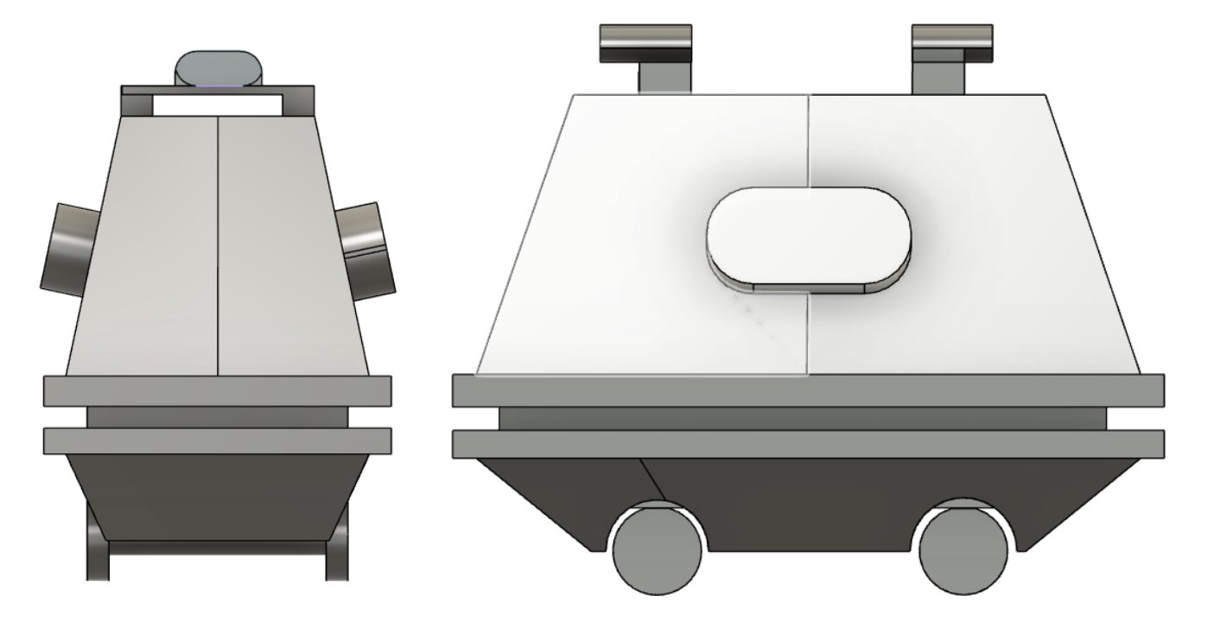
PROJECT OVERVIEW
Speaker: Braden
Project Description - Part 1
MOUSE is a mobile surveillance robot intended for indoor use, in corporate office or residential environments.
There will be a large 18V battery allowing MOUSE to perform surveillance overnight without needing to have its battery replaced. When the battery does die, it will need to be recharged manually.
MOUSE will also have a custom circuit to step down the 18V from the battery to 5V for motors, sensors and ICs, as well as 5V to 3.3V for the microprocessor.
Powered by 4 motors, each controlling its own wheel for mobility. Will have variable speed control through the use of PWM signals.
Original Vision of Final MOUSE Design
Notes:
In this section provide a concise description of your project (you should start with your Project Description from your team website and then elaborate). What is it? What will it do? What differentiates it from similar projects and prior art? Include a relevant picture of your project or “artist rendering” of the completed project.

Slide 4
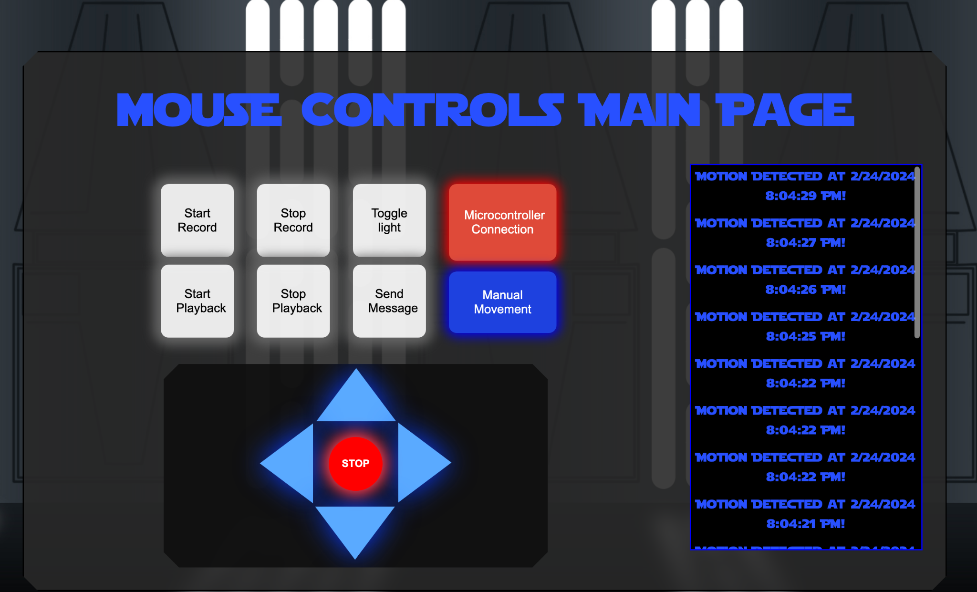
PROJECT OVERVIEW
Speaker: Braden
Project Description - Part2
MOUSE will have PIR sensors on all four sides, allowing for the detection of movement.
Viewable UI on a webpage to use MOUSE movement controls and display if any objects have been detected.
MOUSE and the web interface will send data wirelessly through WiFi via a web server.
.
Current Iteration of MOUSE webpage UI
Notes:
In this section provide a concise description of your project (you should start with your Project Description from your team website and then elaborate). What is it? What will it do? What differentiates it from similar projects and prior art? Include a relevant picture of your project or “artist rendering” of the completed project.

Slide 5
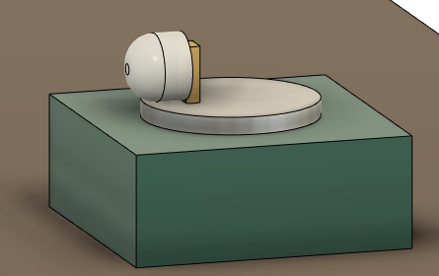
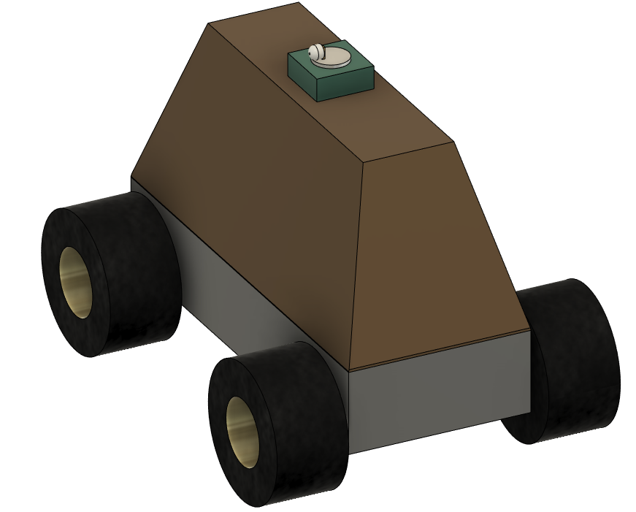
PROJECT OVERVIEW
Speaker: Braden
Project Description - Stretch Goals
The PIR sensors may be mounted to a motor to ensure 360 degree coverage, instead of simply mounting four separate sensors to each side of MOUSE.
MOUSE can follow a predetermined path set by the user.
Top Scanning Section of MOUSE
Modified Final MOUSE Design
Notes:
In this section provide a concise description of your project (you should start with your Project Description from your team website and then elaborate). What is it? What will it do? What differentiates it from similar projects and prior art? Include a relevant picture of your project or “artist rendering” of the completed project. ***add updated image of design with stepper

Slide 6

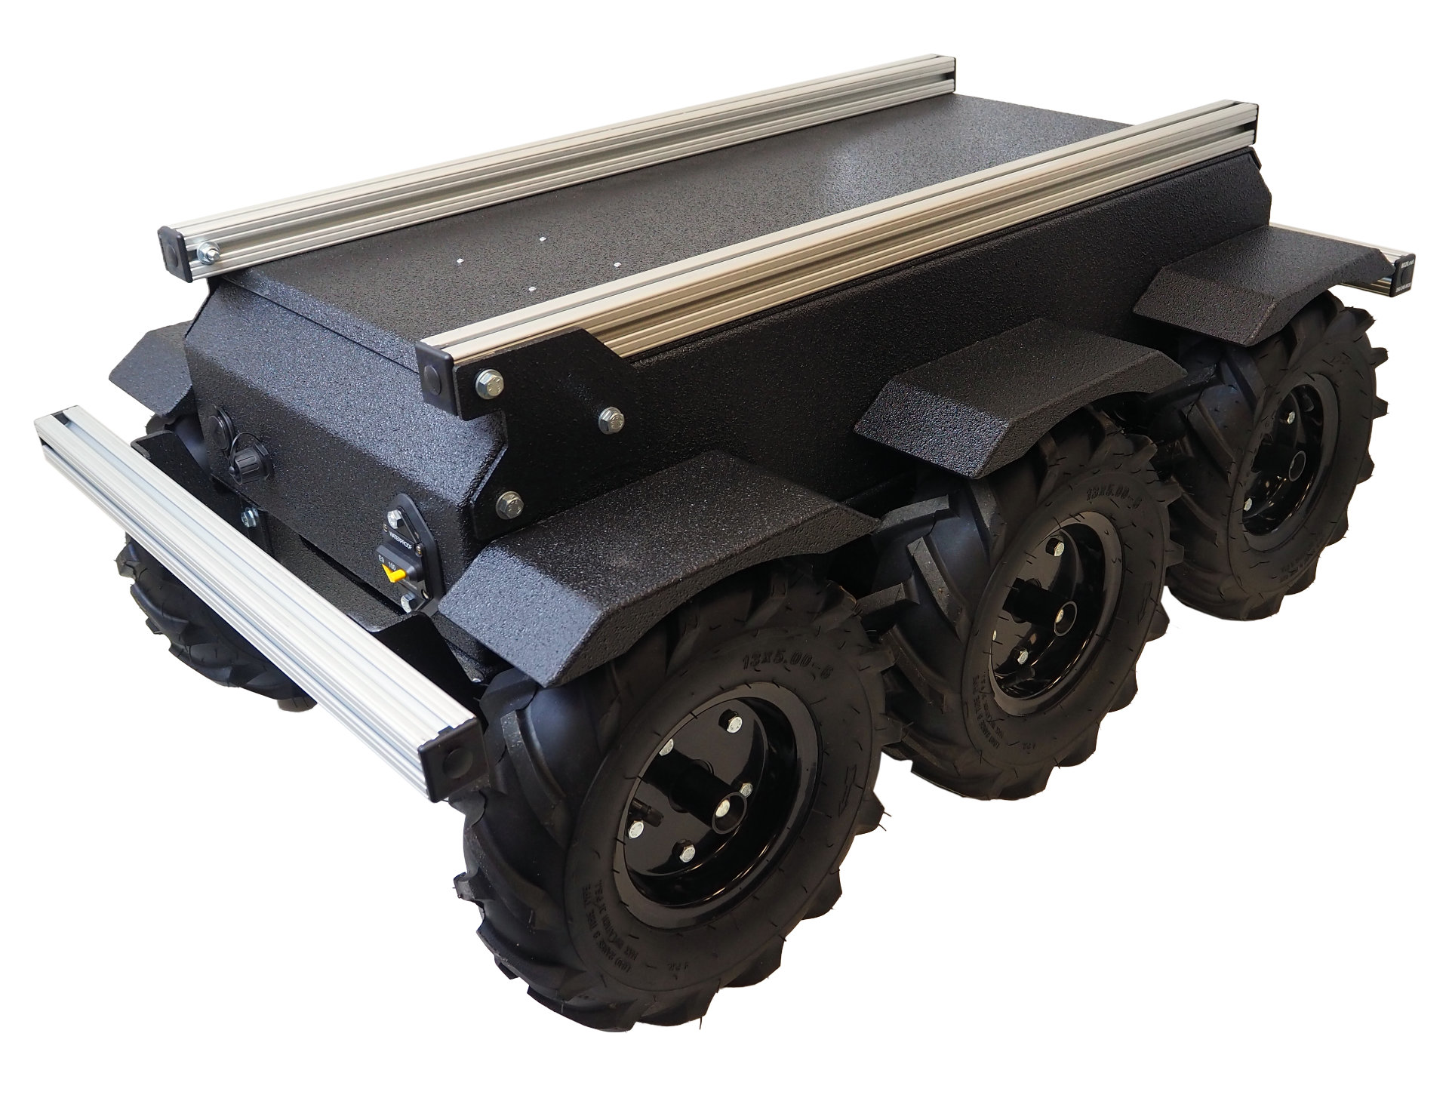
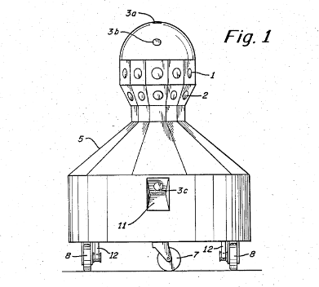
PROJECT OVERVIEW
Speaker: Braden
Why is it Different?
Does not use a camera - no potential for security vulnerabilities in revealing proprietary information from device itself or its online dashboard
Cheaper and more abundant than existing security robots which are shown to cost upwards of $50k (SPAR)
Easily configurable to follow a certain surveillance path using the recording and playback feature
Requires minimal power usage which extends battery life
Notes:
In this section provide a concise description of your project (you should start with your Project Description from your team website and then elaborate). What is it? What will it do? What differentiates it from similar projects and prior art? Include a relevant picture of your project or “artist rendering” of the completed project.

Slide 7
PSDRS
Speaker: Braden
PSDR #1 (Hardware): An ability to control the speed of the motors with PWM signals from the microcontroller.
PSDR #2 (Hardware): An ability to step down 18.5V from the battery to 5V for circuit components on the PCB and motors using a team designed DC switching regulator.
PSDR #3 (Hardware): An ability to utilize LEDs with a daisy chained shift register circuit controlled by the microcontroller to display battery life diagnostic.
PSDR #4 (Software): An ability to display data, such as movement controls and movement detection data to a viewable UI on a webpage.
PSDR #5 (Software): An ability to control the robot by sending data wirelessly through WiFi via a web server.
Stretch PSDR:
Stretch PSDR #1: An ability to record a set path and then play back the same actions: if the robot records a path for 30 seconds, then its playback should be within 1 meter of the original pathing at all times
Stretch PSDR #2: An ability to detect movement by using a PIR sensor that is attached to an motor with an encoder. The microcontroller will control the motor direction using feedback from the encoder, and the microcontroller will read the output of the PIR sensor.

Slide 8
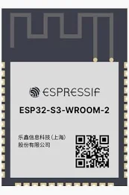
MAJOR COMPONENTS
Speaker: Matt
Microcontroller
Performs logic on signal inputs and outputs based on its software configuration to interact with other electrical design components
Responsible for receiving signals from a web server, controlling motor operation, driving LED diagnostic data, and sending motion detection data according to software integration standards.
Feature | ESP32 | ESP8266 | STM32
WiFi | Yes | Yes | No
Operating Voltage (V) | 3.3 | 3.3 | 2.4-3.6
GPIO Pins (Number) | 34 | 17 | 39
Communication Protocols | SPI/I2C/UART/ADC/DAC | SPI/I2C/UART/ADC/DAC | SPI/I2C/UART/ADC/DAC
PWM Channel (Number) | 16 | 8 | 6
Clock Frequency | Dual Core - 160 MHz & 240 MHz | Single Core - 80 MHz | Single Core - 48 MHz
Price | $6-$12 | $4-$6 | $1-$4
Chosen | Yes | No | No
Notes:
Choose the major (electrical) components being utilized by your design. For each component, provide a brief description of what it is, relevant specifications, and what it will do. Also, provide a couple of alternative components and justify your choice. Examples of major components include the microcontroller, motors, wireless interfaces, power converters and regulators. Examples of relevant specifications include operating speed (uC), number of I/O (uC), stall current (motors), operating voltage, and expected current consumption.

Slide 9
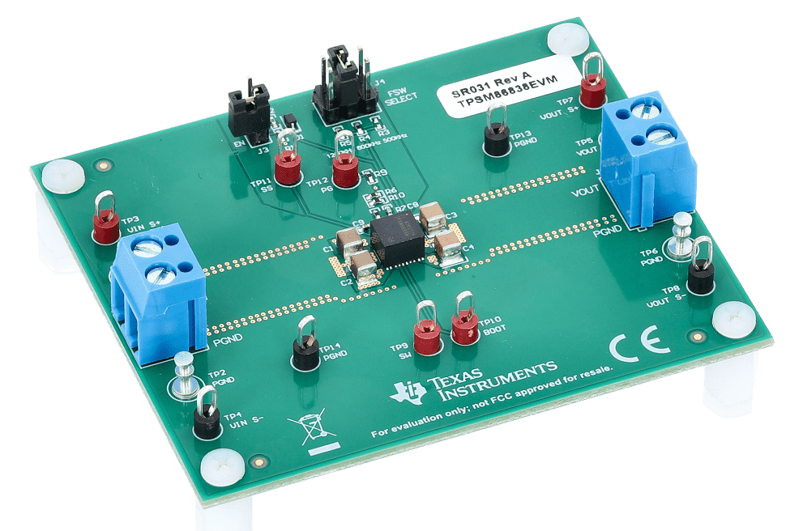
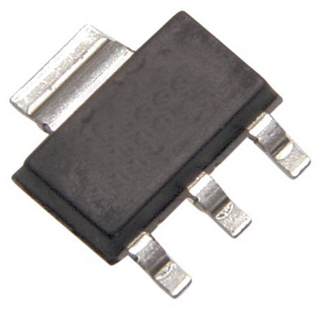
MAJOR COMPONENTS
Speaker: Andrew
Voltage Regulator
Steps down input voltage to a stable level for use by the electrical components in the design
Responsible for performing voltage regulation to transform 18V battery voltage to 5V for use by the motors and motor driver.
A key component in our selection of a Buck Converter is the increased efficiency and complexity to merit a PSDR.
Linear Voltage Regulator |  | Switching Voltage Regulator
Pros | Cons | Pros | Cons
Simple circuit configuration | Relatively poor efficiency | High Efficiency | More external parts required
Few external parts | Considerable heat generation | Low heat generation | Complicated design
Low Noise | Only step-down (buck) operation | Boost/buck/negative voltage operation possible | Increased noise
https://circuitcellar.com/research-design-hub/basics-of-design/voltage-regulators/
Notes:
Choose the major (electrical) components being utilized by your design. For each component, provide a brief description of what it is, relevant specifications, and what it will do. Also, provide a couple of alternative components and justify your choice. Examples of major components include the microcontroller, motors, wireless interfaces, power converters and regulators. Examples of relevant specifications include operating speed (uC), number of I/O (uC), stall current (motors), operating voltage, and expected current consumption.

Slide 10
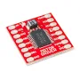
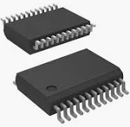
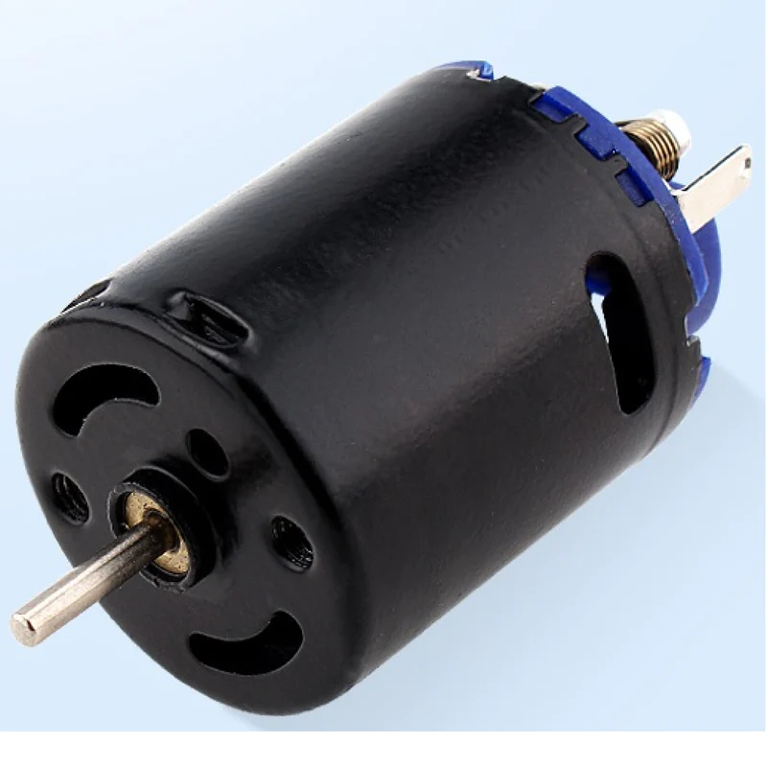
MAJOR COMPONENTS
Speaker: Braden
Motors & Motor Driver
Responsible for receiving GPIO signals from the microcontroller and translating them into mechanical operation for transportation
Manages 5V motor power signal to drive wheels for locomotion with controlled speed and direction.
>1A peak current output per channel for motor stall current
>0.5A continuous current output per channel
Feature | TB6612FNG | A4990 | DRV8833
Number of Motor Channels | 2 | 2 | 2
PWM controllable | Yes | Yes | Yes
Minimum Output Voltage (V) | 4.5 | 6 | 2.7
Maximum Output Voltage (V) | 13.5 | 32 | 10.8
Peak Current Output per Channel (A) | 3 | 0.9 | 2
Max Continuous Current Output per Channel (A) | 1 | 0.7 | 1.2
Price | $4.95 | $7.95 | $9.95
Chosen | Yes | No | No
Notes:
Choose the major (electrical) components being utilized by your design. For each component, provide a brief description of what it is, relevant specifications, and what it will do. Also, provide a couple of alternative components and justify your choice. Examples of major components include the microcontroller, motors, wireless interfaces, power converters and regulators. Examples of relevant specifications include operating speed (uC), number of I/O (uC), stall current (motors), operating voltage, and expected current consumption.

Slide 11
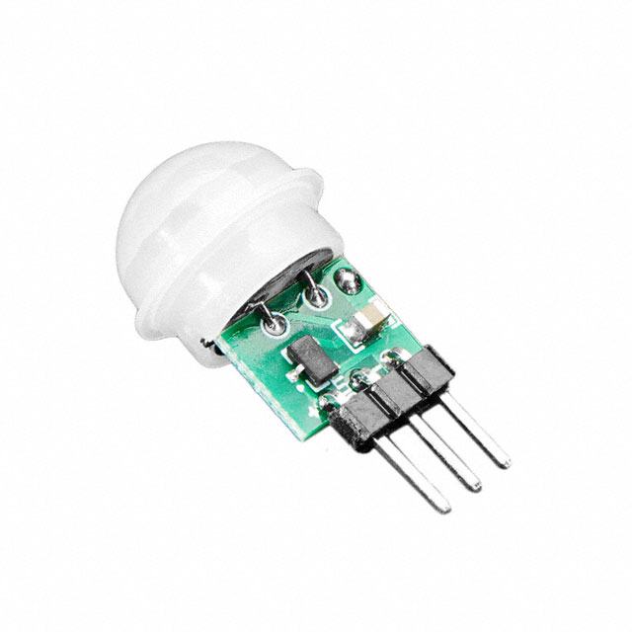
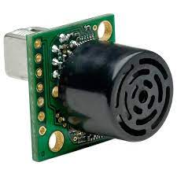
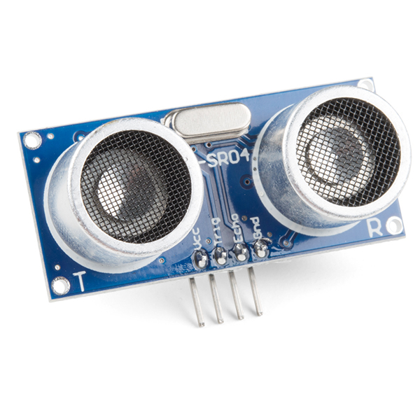
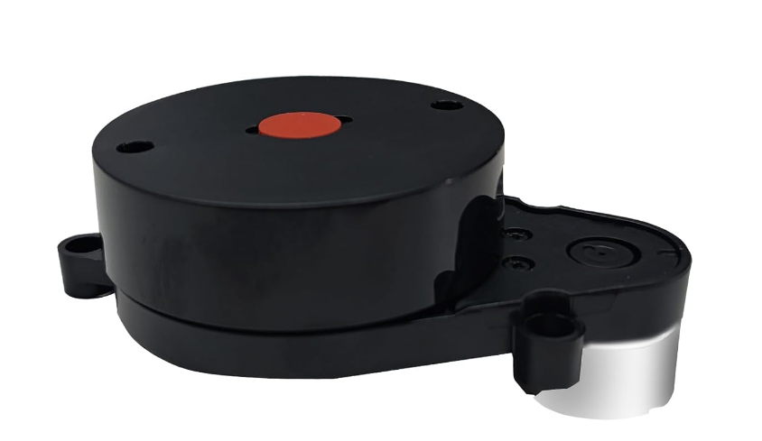
MAJOR COMPONENTS
Speaker: Braden
Motion Detection Sensor
Responsible for taking readings of the environment and transmitting the data back to the microcontroller
Either a digital trigger or an analog stream that needs to be processed for motion detection
A key specification is the ability to produce reliable readings with a reasonable level of sensitivity
Feature | Sonar Sensor | Ultrasonic Sensor | 360° Lidar Sensor | PIR Sensor
Measurement Distance | 7.65m | ~1m | ~12m | ~4m
Angular View Area (degrees) | 48° | 15° | 360° | 125°
Cost | $39.95 | $4.50 | $99.00 | $3.33
Sensitivity in Prototype | N/A | High | N/A | Moderate
Chosen | No | No | No | Yes
Notes:
Choose the major (electrical) components being utilized by your design. For each component, provide a brief description of what it is, relevant specifications, and what it will do. Also, provide a couple of alternative components and justify your choice. Examples of major components include the microcontroller, motors, wireless interfaces, power converters and regulators. Examples of relevant specifications include operating speed (uC), number of I/O (uC), stall current (motors), operating voltage, and expected current consumption.

Slide 12
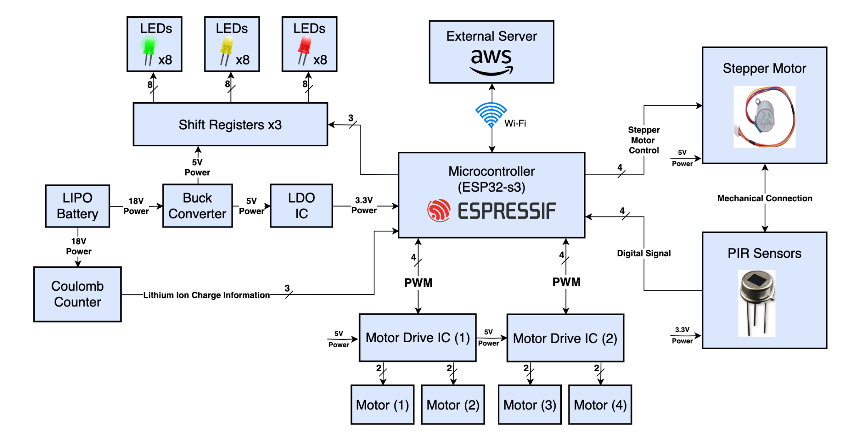
BLOCK DIAGRAM
Speaker: Chris
Notes:
Include one or more images of your system block diagram(s) here. Block diagrams should include all relevant major parts and systems, bus widths, and interface types. Don’t forget the power network.

Slide 13
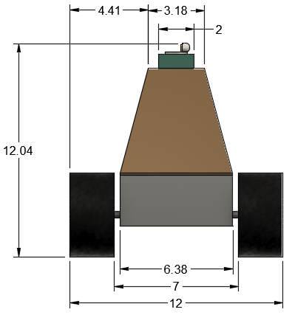
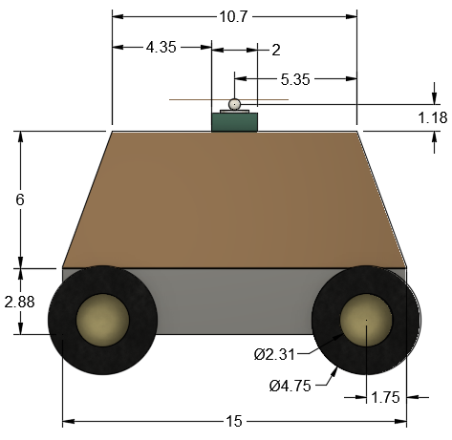
PACKAGING DESIGN
Speaker: Andrew
Dimensioned CAD Model
PIR Sensor and motor
3D printed Shell
Front View (in)
Side View (in)
Rubber Wheels
Aluminum Chassis
Notes:
Include one or more images of your packaging design here. Include relevant dimensions, label main components, and discuss how you are planning to manufacture your product packaging.

Slide 14
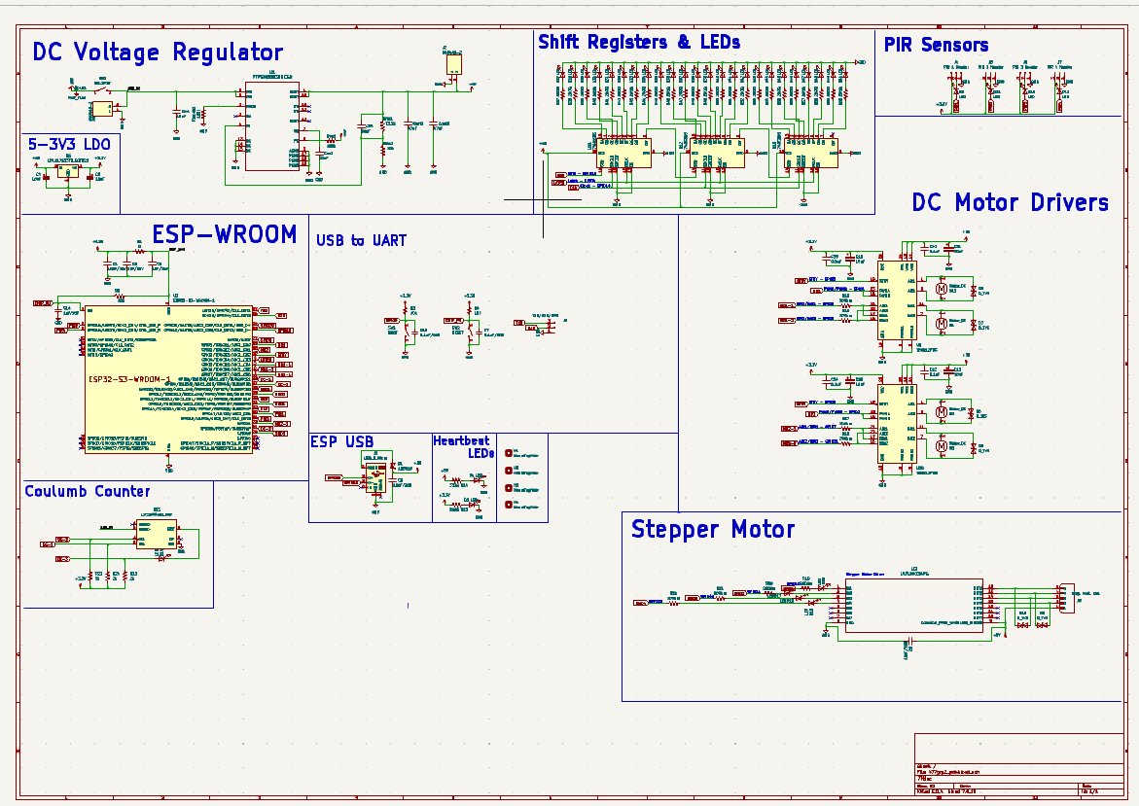
ELECTRICAL SCHEMATIC
Speaker: Chris
Full Schematic
Notes:
Include one or more views of your electrical schematic here. If necessary, break up this section into multiple slides detailing various subsystems which are easily viewable (Hint: a zoomed out view of a large electrical schematic in which nothing can be read will not be helpful for the design review). Your schematics should be complete, organized, and readable.

Slide 15
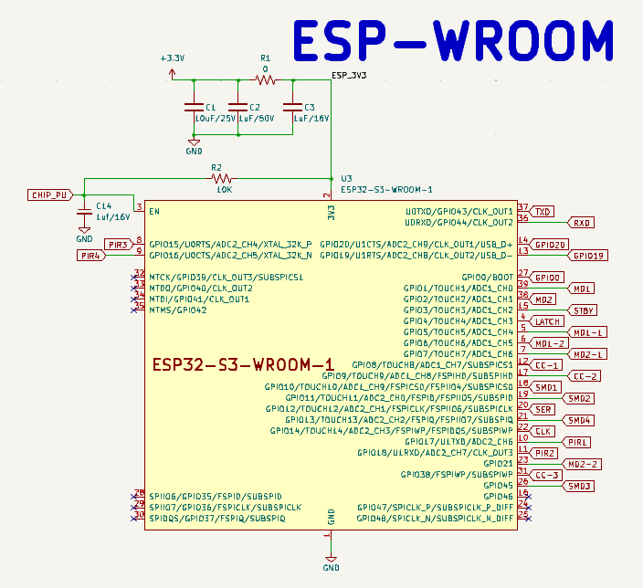
ELECTRICAL SCHEMATIC
Speaker: Chris
ESP
Notes:
Include one or more views of your electrical schematic here. If necessary, break up this section into multiple slides detailing various subsystems which are easily viewable (Hint: a zoomed out view of a large electrical schematic in which nothing can be read will not be helpful for the design review). Your schematics should be complete, organized, and readable.

Slide 16
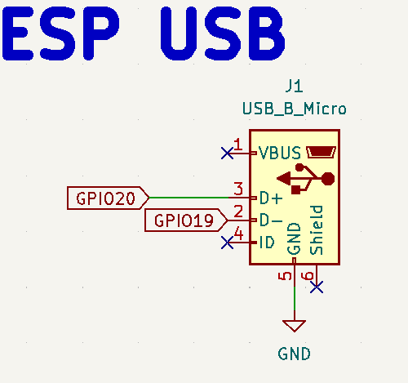
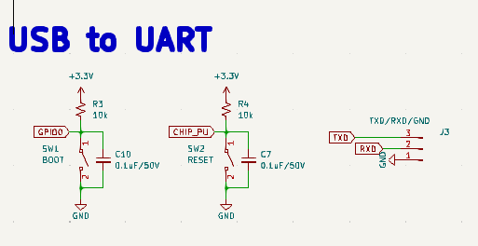
ELECTRICAL SCHEMATIC
Speaker: Chris
ESP [cont..]
Notes:
Include one or more views of your electrical schematic here. If necessary, break up this section into multiple slides detailing various subsystems which are easily viewable (Hint: a zoomed out view of a large electrical schematic in which nothing can be read will not be helpful for the design review). Your schematics should be complete, organized, and readable.

Slide 17
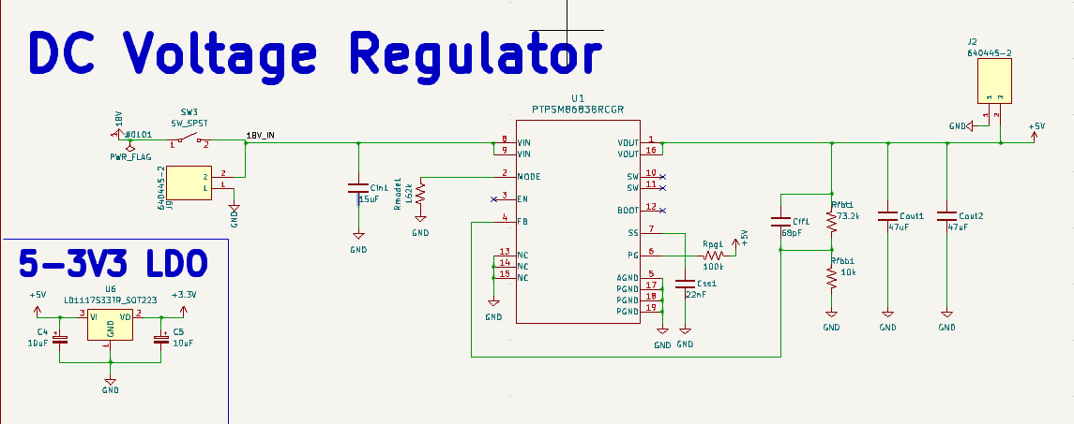
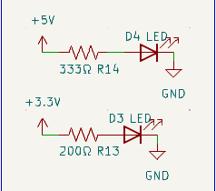
ELECTRICAL SCHEMATIC
Speaker: Andrew
DC Voltage Regulator and LDO
Notes:
Include one or more views of your electrical schematic here. If necessary, break up this section into multiple slides detailing various subsystems which are easily viewable (Hint: a zoomed out view of a large electrical schematic in which nothing can be read will not be helpful for the design review). Your schematics should be complete, organized, and readable.

Slide 18
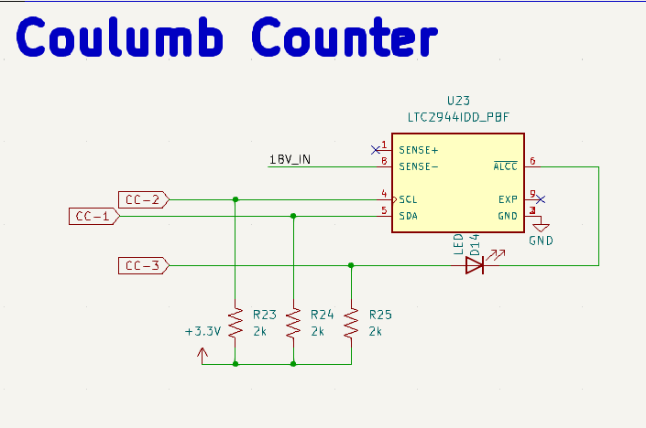
ELECTRICAL SCHEMATIC
Speaker: Andrew
Coulomb Counter
Notes:
Include one or more views of your electrical schematic here. If necessary, break up this section into multiple slides detailing various subsystems which are easily viewable (Hint: a zoomed out view of a large electrical schematic in which nothing can be read will not be helpful for the design review). Your schematics should be complete, organized, and readable.

Slide 19
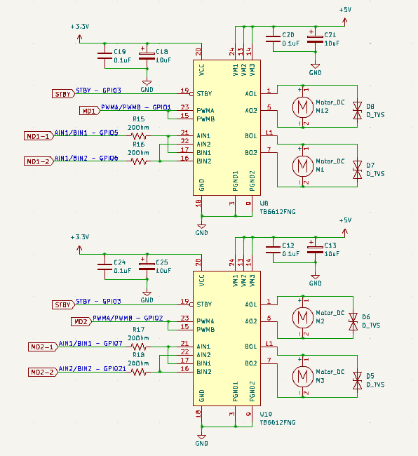
ELECTRICAL SCHEMATIC
Speaker: Chris
DC Motor Drivers
Notes:
Include one or more views of your electrical schematic here. If necessary, break up this section into multiple slides detailing various subsystems which are easily viewable (Hint: a zoomed out view of a large electrical schematic in which nothing can be read will not be helpful for the design review). Your schematics should be complete, organized, and readable.

Slide 20
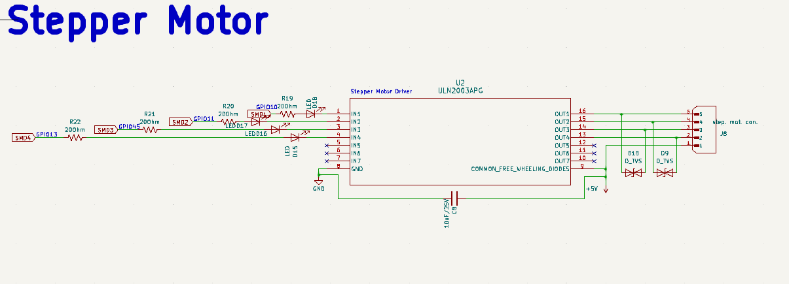
ELECTRICAL SCHEMATIC
Speaker: Andrew
Stepper Motor
Notes:
Include one or more views of your electrical schematic here. If necessary, break up this section into multiple slides detailing various subsystems which are easily viewable (Hint: a zoomed out view of a large electrical schematic in which nothing can be read will not be helpful for the design review). Your schematics should be complete, organized, and readable.

Slide 21
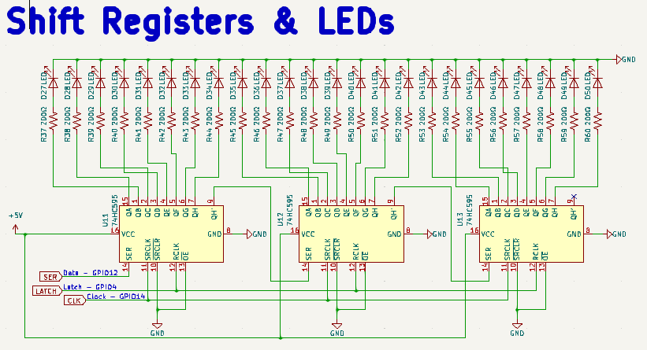
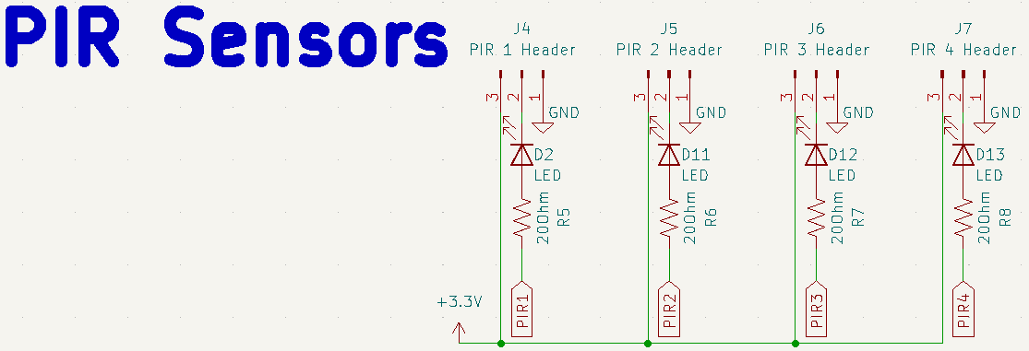
ELECTRICAL SCHEMATIC
Speaker: Andrew
Shift Registers & LEDs and PIR Sensors
Notes:
Include one or more views of your electrical schematic here. If necessary, break up this section into multiple slides detailing various subsystems which are easily viewable (Hint: a zoomed out view of a large electrical schematic in which nothing can be read will not be helpful for the design review). Your schematics should be complete, organized, and readable.

Slide 22
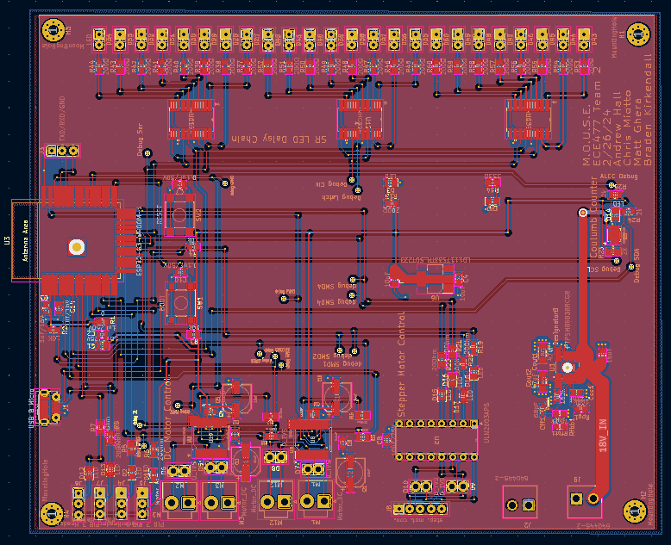
PCB LAYOUT
Speaker: Andrew
Full Layout
Top 5V plane
Bottom GND plane
Debugging vias
145.9mm x 121.9mm
Notes:
Include one or more views of your PCB Layout here. If necessary, break up this section into multiple slides detailing various subsystems which are easily viewable (Hint: a zoomed out view of a large electrical schematic in which nothing can be read will not be helpful for the design review). Your layout should be complete, organized, and readable.

Slide 23
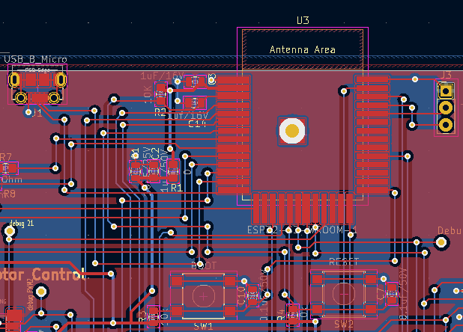
PCB LAYOUT
Speaker: Chris
ESP / ESP USB / USB to UART
Notes:
Include one or more views of your PCB Layout here. If necessary, break up this section into multiple slides detailing various subsystems which are easily viewable (Hint: a zoomed out view of a large electrical schematic in which nothing can be read will not be helpful for the design review). Your layout should be complete, organized, and readable.

Slide 24
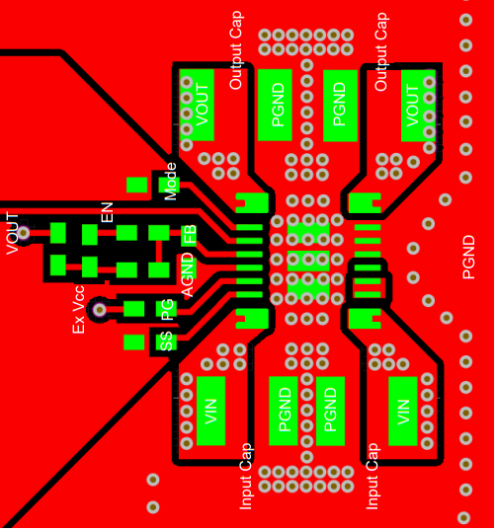
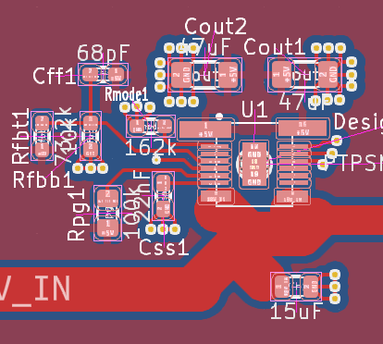
PCB LAYOUT
Speaker: Andrew
DC Voltage Regulator
Notes:
Include one or more views of your PCB Layout here. If necessary, break up this section into multiple slides detailing various subsystems which are easily viewable (Hint: a zoomed out view of a large electrical schematic in which nothing can be read will not be helpful for the design review). Your layout should be complete, organized, and readable.

Slide 25
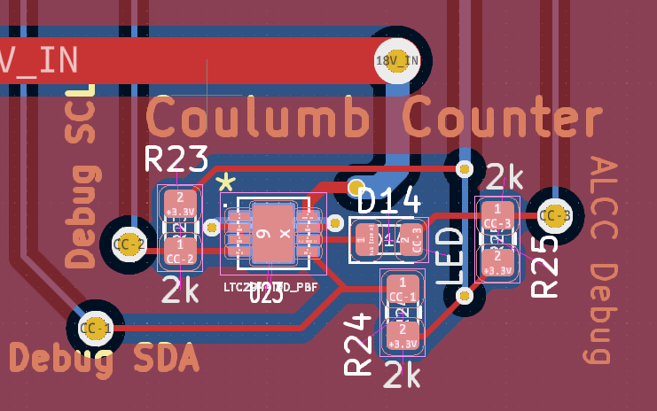
PCB LAYOUT
Speaker: Andrew
Coulomb Counter
Notes:
Include one or more views of your PCB Layout here. If necessary, break up this section into multiple slides detailing various subsystems which are easily viewable (Hint: a zoomed out view of a large electrical schematic in which nothing can be read will not be helpful for the design review). Your layout should be complete, organized, and readable.

Slide 26
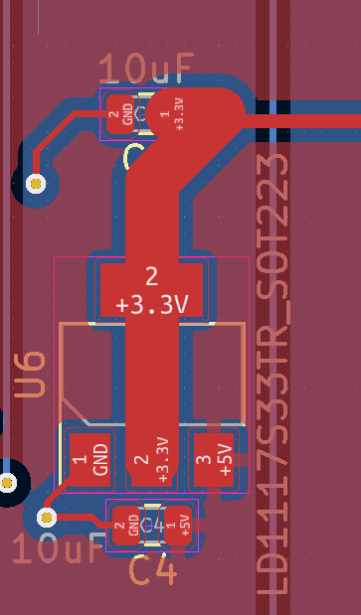
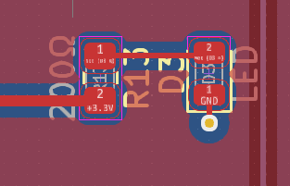
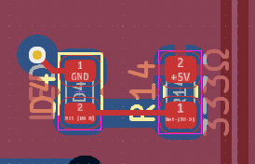
PCB LAYOUT
Speaker: Andrew
5V to 3.3V LDO with heartbeat LEDs
Notes:
Include one or more views of your PCB Layout here. If necessary, break up this section into multiple slides detailing various subsystems which are easily viewable (Hint: a zoomed out view of a large electrical schematic in which nothing can be read will not be helpful for the design review). Your layout should be complete, organized, and readable.

Slide 27
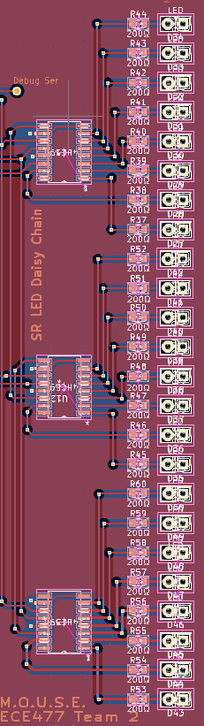
PCB LAYOUT
Speaker: Andrew
Shift Registers & LEDs
Notes:
Include one or more views of your PCB Layout here. If necessary, break up this section into multiple slides detailing various subsystems which are easily viewable (Hint: a zoomed out view of a large electrical schematic in which nothing can be read will not be helpful for the design review). Your layout should be complete, organized, and readable.

Slide 28
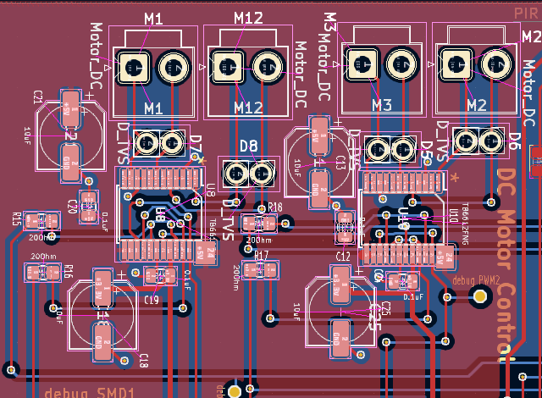
PCB LAYOUT
Speaker: Chris
DC Motor Control
Notes:
Include one or more views of your PCB Layout here. If necessary, break up this section into multiple slides detailing various subsystems which are easily viewable (Hint: a zoomed out view of a large electrical schematic in which nothing can be read will not be helpful for the design review). Your layout should be complete, organized, and readable.

Slide 29
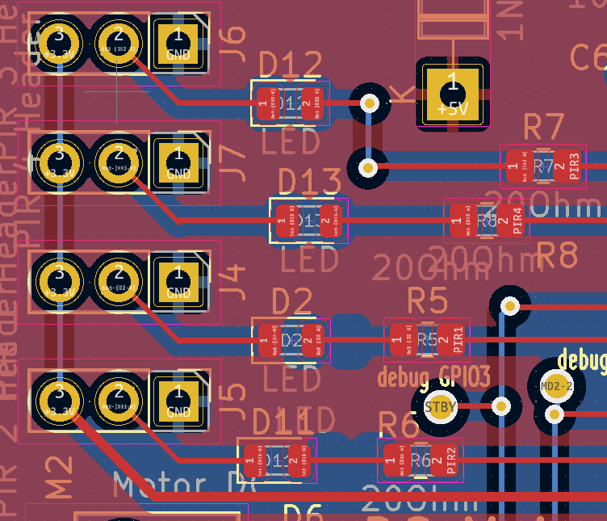
PCB LAYOUT
Speaker: Matt
PIR Sensors
Notes:
Include one or more views of your PCB Layout here. If necessary, break up this section into multiple slides detailing various subsystems which are easily viewable (Hint: a zoomed out view of a large electrical schematic in which nothing can be read will not be helpful for the design review). Your layout should be complete, organized, and readable.

Slide 30
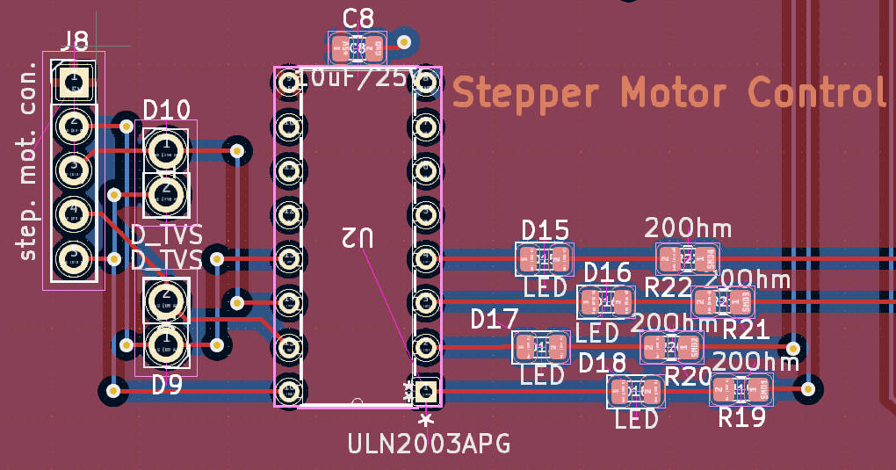
PCB LAYOUT
Speaker: Matt
Stepper Motor Control
Notes:
Include one or more views of your PCB Layout here. If necessary, break up this section into multiple slides detailing various subsystems which are easily viewable (Hint: a zoomed out view of a large electrical schematic in which nothing can be read will not be helpful for the design review). Your layout should be complete, organized, and readable.

Slide 31
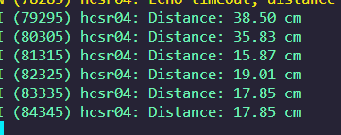
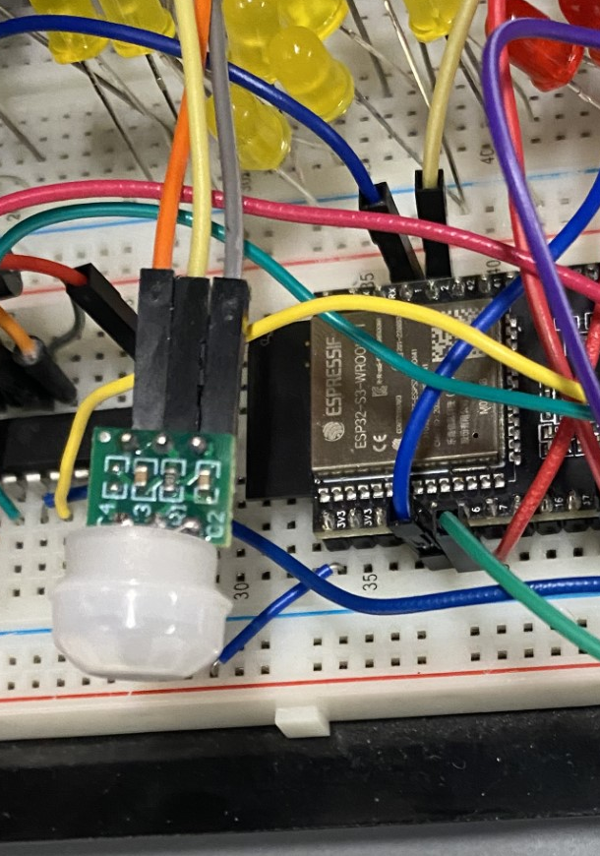
PROTOTYPING PROGRESS
Speaker: Braden
Prototyped
Sonar Sensor
Unable to generate any signal output
Likely faulty or damaged and expensive to replace
Ultrasonic Sensor
Generally correct but high variance in input readings
Not granular enough for our application, especially at distances more than 3 feet away from the sensor
PIR Sensor
Much more reliable motion detection
Easier to use as signal is preprocessed into a digital output
Tested to work effectively until ~12ft, haven’t tested past that yet
Ultrasonic Sensor Data Log
PIR Sensor Prototyping

Slide 32
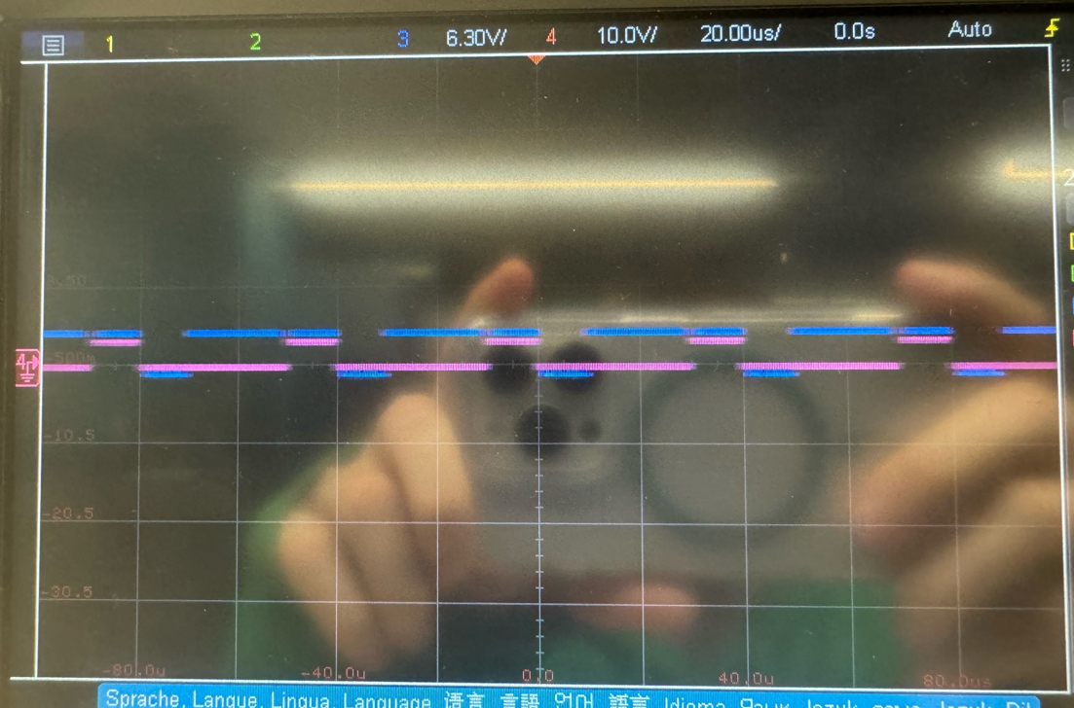
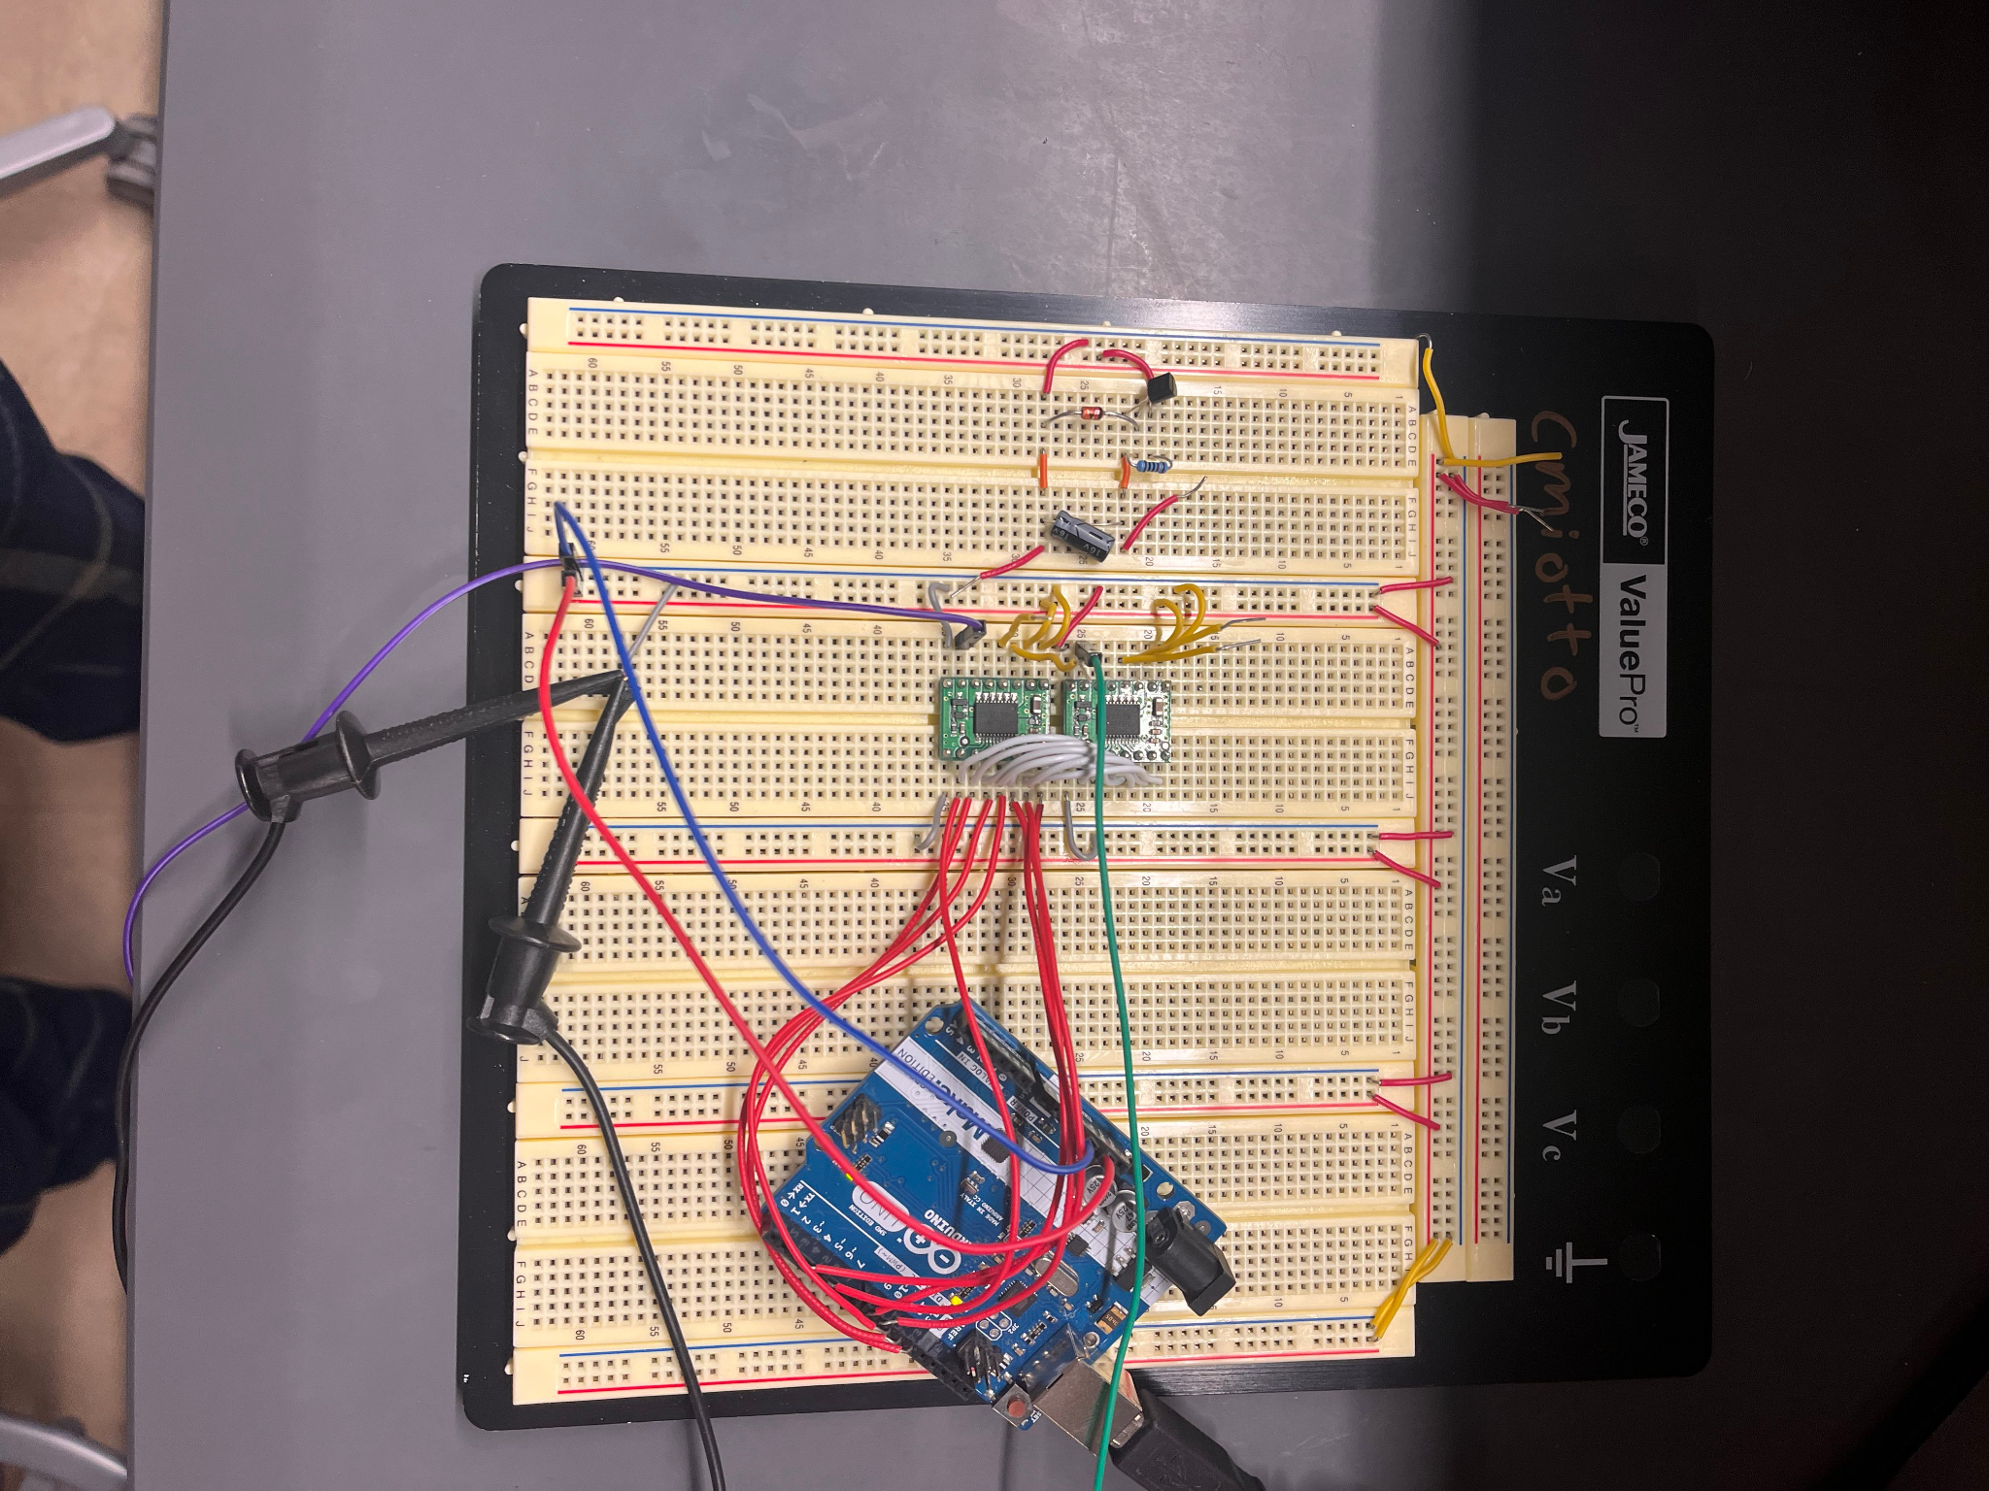
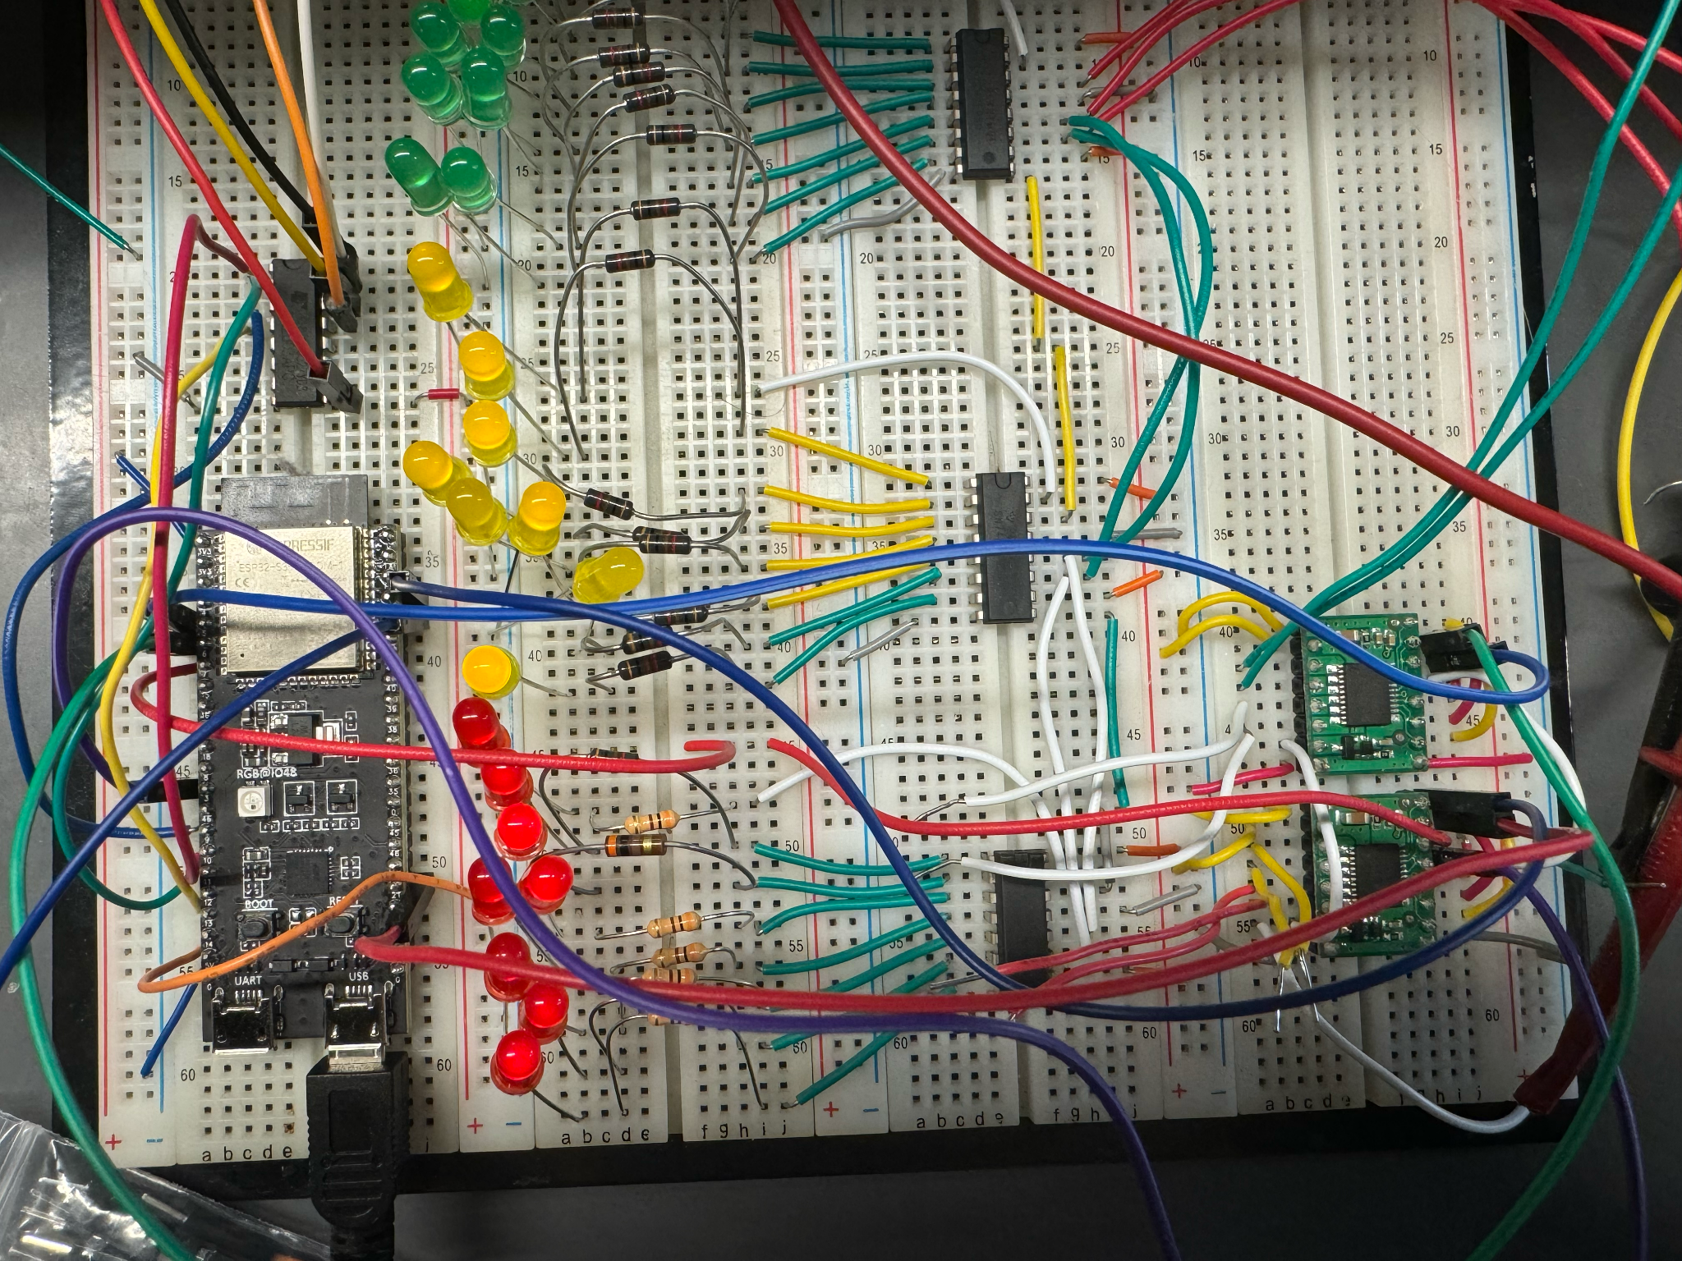
PROTOTYPING PROGRESS
Speaker: Matt
Prototyped
Websocket Communication
Communication between micro|server & web-UI|server
Motion alerts, DC/stepper motor controls
Achieved ≤1 second latency
DC Motors w/ PWM
PWM and motor control signal generation
Able to control output frequency and motor polarity of multiple signals simultaneously
LED Shift Register Array
Able to control 24 individual LEDs
Need to implement Coulomb counter as data input
Stepper Motor
Directional control and step count measuring
Can rotate controlled angular distances

Slide 33
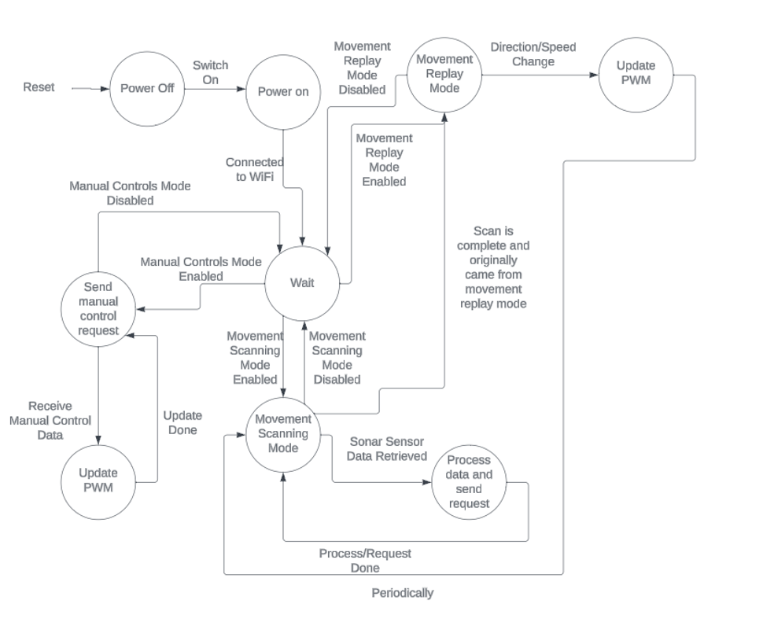
SOFTWARE OVERVIEW
Speaker: Matt

Slide 34
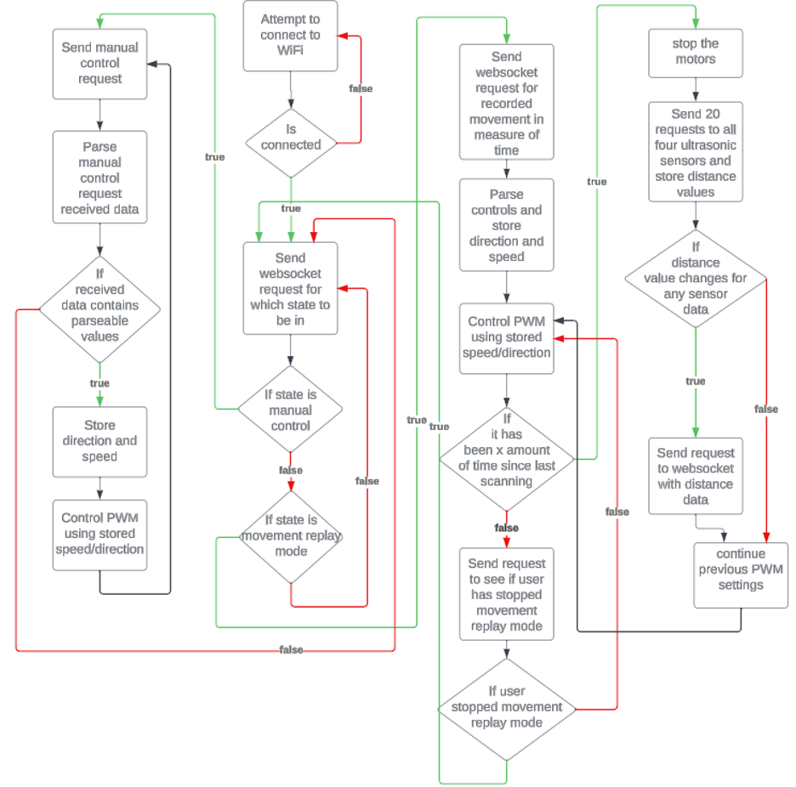
SOFTWARE OVERVIEW
Speaker: Matt

Slide 35
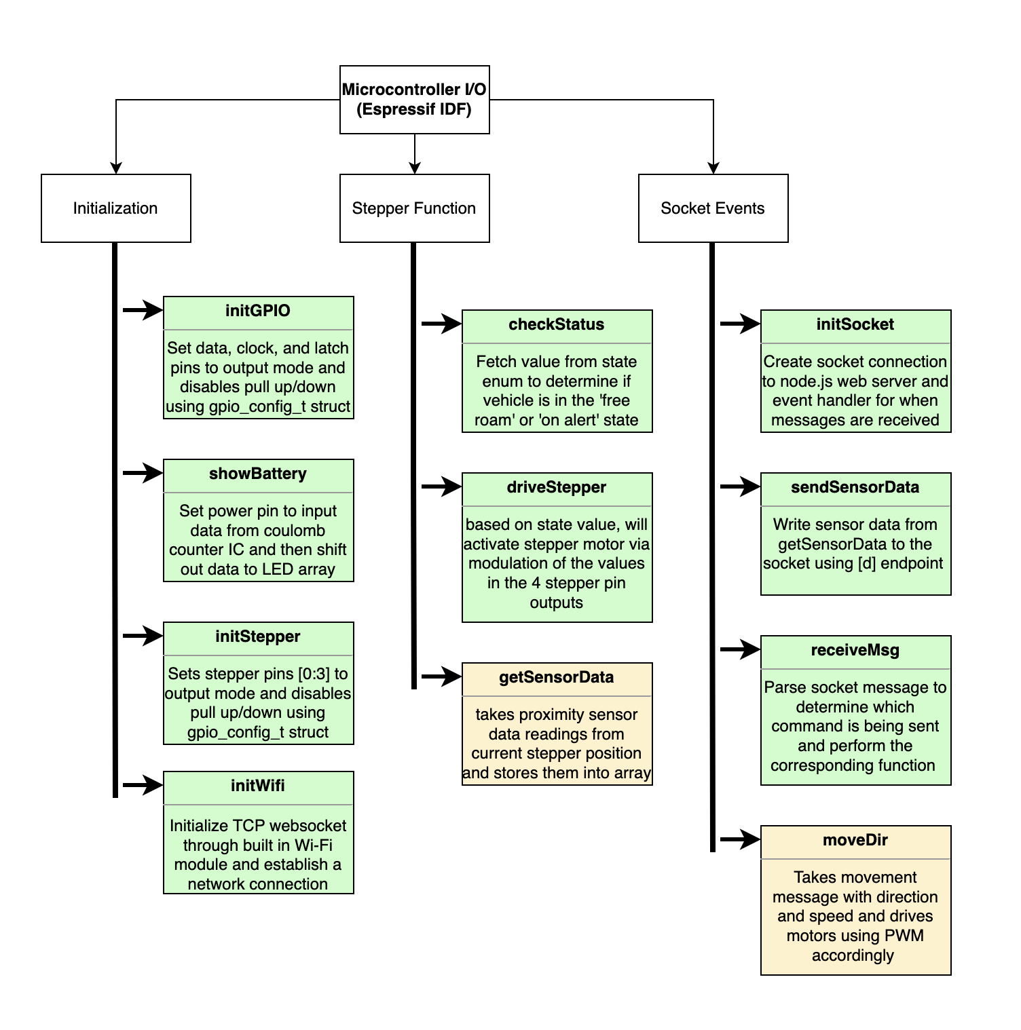
SOFTWARE DEVELOPMENT STATUS
Speaker: Matt
Prototyped
Websocket Communication
overall infrastructure,
able to store inputs/states,
setting/reading motor direction
setting/reading movement detection time
DC Motor Control
PWM signal generation
Motor Driver Testing
Basic Socket Command Hook
LED Control
Serial control of individual LEDs
Stepper Motor Control
Control stepper motor direction and read the step count
Key: Completed
In Progress

Slide 36

SOFTWARE OVERVIEW
Speaker: Matt
Prototyped
Backend Socket Communication
Creates sockets with micro and webclients
Defined message schema for receiving and sending data
Broadcasts alerts to all webclient connections
Processes data according to current state
Prototyping
Movement Recording/Playback
Record input timings from dashboard and playback recording file with time delays and looping features
Have working at high level but will likely need to fine-tune delays with full movement capabilities
Key: Completed
In Progress

Slide 37

SOFTWARE OVERVIEW
Speaker: Matt
Prototyped
UI Dashboard
Active connection status
Manual movement/scanning mode
Integrated directional commands
State management of recording/playback/free roam

Slide 38

PROJECT TIMELINE
Speaker: Andrew
GANTT CHART

Slide 39
3D PRINTING
Questions?

